Slide 1
ELSEWeb meets SADI: Supporting Data-to-Model Integration for Biodiversity Forecasting
Nicholas Del Rio¹, Natalia Villanueva-Rosales¹, Deana Pennington¹, Karl Benedict², Aimee Stewart³ and Cj Grady³
University of Texas at El Paso Cyber-ShARE¹
University of New Mexico Earth Data Analysis Center²
Kansas University Biodiversity Institute³

Slide 2
Outline
Understanding ELSEWeb and the Model Web
Enabling Discovery through Ontologies
Enabling Transformation through SADI
Service Orchestration through SHARE
Modeling and Chihuahuan Desert in ELSEWeb
Making Sense of Results Through Provenance

Slide 3
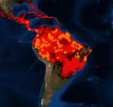
A Pattern for Data-to-Model Web
“This Model Web would be a system of interoperable computer models and databases communicating primarily via web services” – Geller 2009
Modeling Environment
(Web Coverage Service)
Web Client
Modeling Service (Web Processing Service)
Species Data (Database)
Data and Models are exposed as Open Geospatial Consortium (OGC) services
The pattern was suggested and employed by the eHabitat system

Slide 4
Potential Limitations of Pattern
Where can I find relevant data?
Discovery Limitations
Interface Requirement Disparities: formats and type transformations
What transformations are required to satisfy requirements?
Web Client
Modeling Service (Web Processing Service)
What metadata standard(s) are being employed? Is the data relevant for my purposes?
Metadata interpretation

Slide 5

Earth, Life, and Semantic Web
ELSEWeb streamlines the flow of heterogeneous geographic, social, and geological data into Lifemapper modeling services through semantic mediation
Earth Data Analysis (EDAC) WCS Data
1
Supports Data Discovery
Semantic Metadata
2
Provides an extensible set of transformation services
Adapter KB
Lifemapper
(RESTful)
3
Generates adaptor execution plans
Orchestration Agent
Lifemapper Species Data
ELSEWeb Semantic Mediation Layer

Slide 6
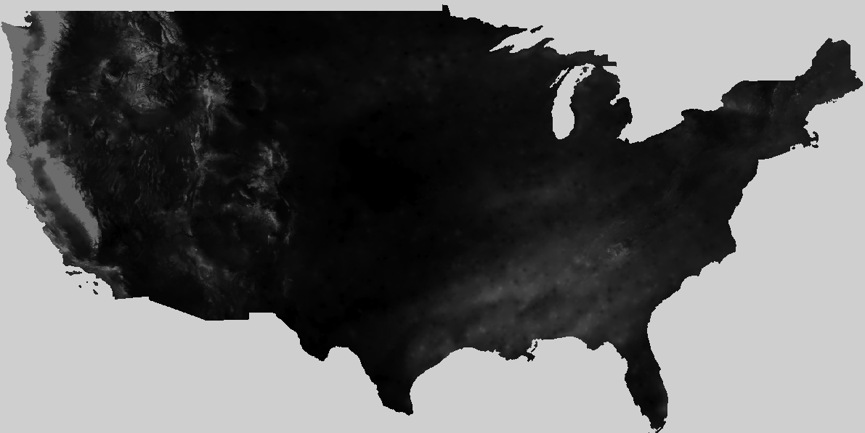
ELSEWeb Components
Metadata
OWL
Metadata
Individuals
EDAC Data
1
Semantic
MetaData
Selector Service
2
Adaptor Service 1
Adaptor
KB
3
cardioSHARE + Pellet
(handles adaptor orchestration)
Adaptor Service n
Experiment Specifications RDF
Model Generation Query (SPARQL)
Lifemapper Service
SADI Service OWL

Slide 7
Harvesting from Earth Data Analysis Center
CF Keywords
GCMD
Categories
WCS Get Capabilities
XML
FGDC XML
ISO
19115
Topic
Categories
Metadata Store
Harvesting: translate metadata descriptions into our ELSEWeb data model
Semantic
Metadata
Data Store
WCS Data = Multipart MIME = Payload Tiff + Metadata
Harvested Data Breakdown of 6656 Datasets
CF | dew_point_temperature | degrees celsius * 100 | 1532
 | precipitation_amount | Millimeters times 100 | 1532
 | air_temperature | degrees celsius * 100 | 3064
GCMD_Science | LAND SURFACE TEMPERATURE | bit field | 424
 | VEGETATION INDEX | unitless | 104

Slide 8
Desirable Semantic Metadata Model
The ELSEWeb Semantic Data model was designed to support the following concerns:
What kind of data?
Observation Ontology (OBOE): Describes data in terms of entities (i.e., the physical thing being measured and it characteristics (i.e., properties)
Where can I get the data?
Data Catalog Vocabulary (DCAT): Describes non-RDF datasets in terms of spatial/temporal coverage, format, and themes
How was the data generated
Who was responsible for publishing?
When was it generated?
Provenance Ontology (PROV-O): W3C recommendation for interchanging provenance modeled in PROV

Slide 9
Partial Semantic Data Model
Catalog
dcat:dataset
Dataset
dcat:distribution
Distribution
rdfs:subClassOf
dc:temporal
WCSCoverage
Dataset
dc:spatial
PeriodOfTime
Location
oboe:ofCharacteristic
oboe:measurementFor
Characteristic
Measurement
Observation
DCAT
oboe:ofEntity
prov:wasAssociatedWith
ELSEWeb
Entity
OBOE
Agent
PROVO
http://ontology.cybershare.utep.edu/ELSEWeb/elsewebdata.owl

Slide 10
Mapping CF to OBOE
CF vocabulary couples entities with measurements, so we need to decompose:
dew_point_temperature
Entity
Characteristic
Prepackaged with
OBOE.owl
Atmospheric Feature
Temperature
DewPoint
Need to reuse other ontologies such as SWEET or define own classes.
An ELSEWeb extension

Slide 11
Describing Adaptors using SADI
Adaptor services perform operations such as:
Data selection – binds specifications to satisfactory data
Data transformations – transform structure or format of data
Modeling – implement modeling algorithm
Adaptor services are implemented as Semantic Automated Discovery and Integration (SADI) Services:
outputParameter
Parameter
ServiceDescription
Operation
objectType
hasOperation
inputParameter
owl:Class
Input/Output Class
SADI OWL
Adaptor KB

Slide 12
An Example SADI Service: Tiff Scenario Extraction
Tiff Scenario Extraction Service: extracts Tiff payload from multipart MIME WCS response messages
Distribution
rdfs:subClassOf
elseweb:hasWCSCoverageDistribution 1..10
WCSCoverage
Distribution
WCSScenario
myGrid:inputParameter
SADI OWL
rdfs:subClassOf
rdfs:subClassOf
WCSPayloadExtractor
ELSEWeb OWL
myGrid:outputParameter
TiffExtracted
WCSScenario
Elseweb:hasExtractedTiffScenario
WCSPayload
http://visko.cybershare.utep.edu/sadi-services-elseweb/
12

Slide 13

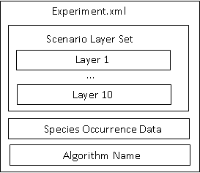
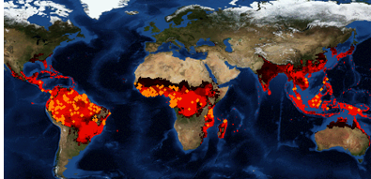
Input
Species distribution modelers exposed as RESTful services and defined using WADL and XML Schema
Can reference Lifemapper’s extensive repository of species occurrence data or provide own
Supported modeling algorithms:
Artificial Neural Network
Maximum Entropy - ATT Implementation
BIOCLIM
Climate Space Model
GARP with Best Subsets
Maximum Entropy
Output
http://lifemapper.org/

Slide 14
Coordinating Adaptor Execution
The carioSHARE agent constructs a knowledge base that supports the answering of an input SPARQL query that requests for some species distribution model
The cardioSHARE client gather triples either inferred from Pellet or returned from a SADI services in an attempt to satisfy the required query pattern
ELSEWeb Adaptor Services
select ?experiment ?modelURL
from <http://ontology.cybershare.utep.edu/experiment-1.owl>
where
{
?scenario a scenario:SatisfiedScenarioRequirements.
?scenario scenario:hasSatisfactoryWCSScenario ?wcsScenario.
?wcsScenario a scenario:TiffExtractedWCSScenario.
?wcsScenario scenario:hasExtractedTiffScenario ?tiffScenario.
?experiment lifemapper:hasLifemapperScenario ?tiffScenario.
?experiment lifemapper:hasModel ?model.
?model lifemapper:hasModelURL ?modelURL.
?experiment a lifemapper:CompletedExperiment.
}
Query Session KB
cardioSHARE
Experiment Specifications RDF
Model Generation Query (SPARQL)
Referenced via FROM clause in query

Slide 15
Experiment Specification Ontology
hasModelingAlgorithm
ExperimentSpecification
ModelingAlgorithm
hasScenarioRequirements
hasOccurrenceSetID
hasModelingParameter
WCSScenario
Requirements
OccurrenceSet
Data
Parameter
cardioSHARE executes sequence of SADI services that support this transformation
Class: ExecutableExperiment
EquivalentTo:
(hasLifemapperScenario some LifemapperScenario)
and (hasModelingAlgorithm some ModelingAlgorithm)
and (hasOccurrenceSetID some rdfs:Literal)
and (hasScenarioLayerUnits some rdfs:Literal)
TiffScenario =
LifemapperScenario
ExecutableExperiment
hasScenario
Lifemapper SADI services ingests ExecutableExperiments
http://ontology.cybershare.utep.edu/ELSEWeb/lifemapper.owl

Slide 16
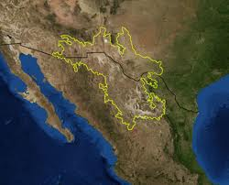
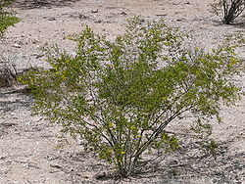
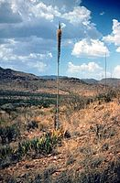
Use Case: Chihuahuan Desert Encroachment
Region: Northern Mexico, West Texas and Southern New Mexico
Terrain: Basins and Mountain Ranges
Climate: Mild Summer (35 – 40° C)
Flora:
Larrea Tridentata
Observation: Over the past 100 years, the Chihuahuan desert has encroached on existing grasslands, resulting in altered erosion patterns and thus an altered landscape.
Agave lechuguilla
Notes:
More informative title!!!! For example: the semantics of the scientific question

Slide 17
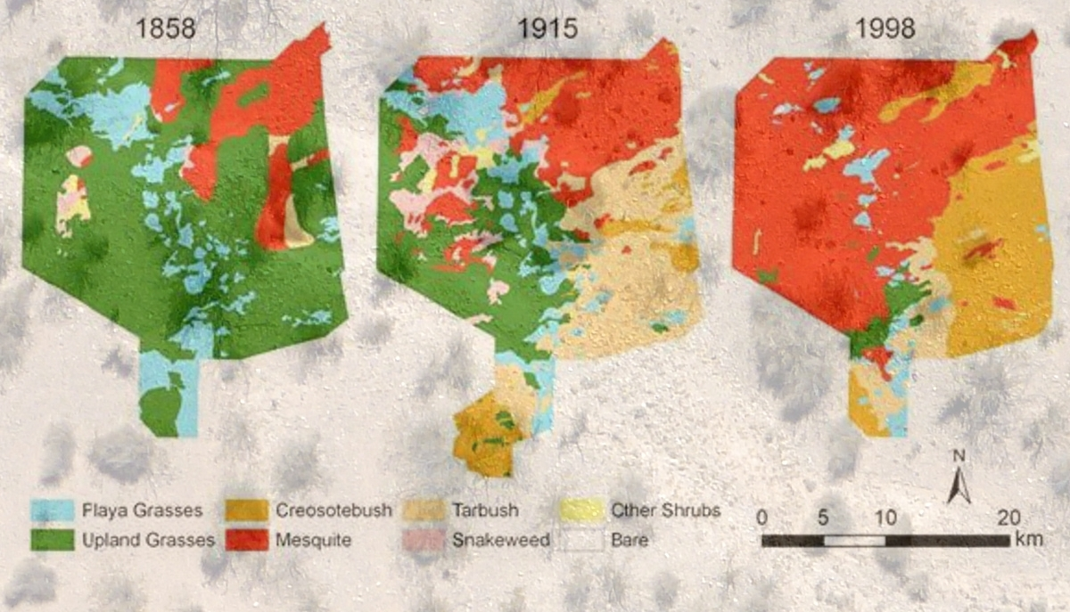
Transition from Grassland to Desert

Slide 18
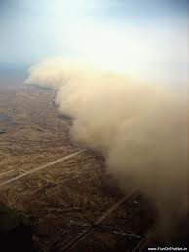
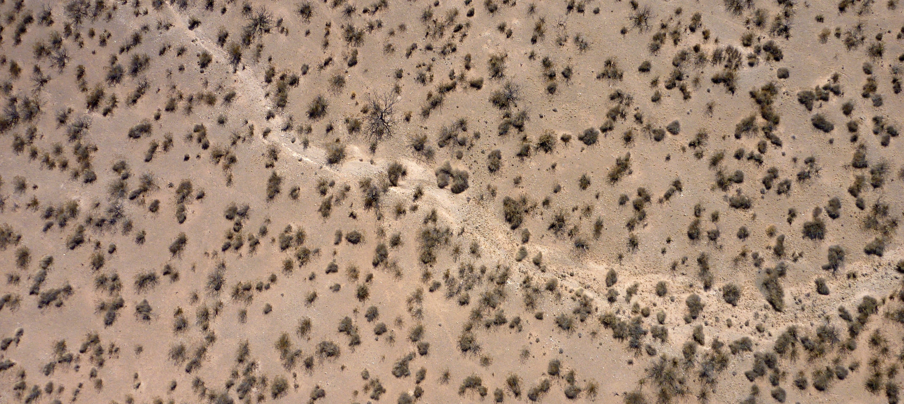
Implications of an Encroaching Desert Ecosystem
Sparse vegetation of the Chihuahuan desert
Dust storms containing allergens such as fungus
Sparse vegetation of mesquite shrubs leads to altered erosion patterns, creating an environment suitable for dust storms.
Notes:
Get high resolution pics from Fransca from viz wall. Get them from Frank ☺ Possible video, test to see if works. Be sure to give credit

Slide 19
Chihuahuan Related Inquiries
Predictions: If we move to hotter climates with more variable precipitation, will we get further encroachment in the desert?
Will we get more erosion?
Will we get higher flood events?
Species Distribution Models (SDM), such as Lifemapper, can provide insight:
“I want to model the transition from grassland to Chihuahuan desert during historic regions of drought”
Notes:
List all people at teams: lifemapper, edac, and UTEP. Include all people even non-authors. Introduce in the beginning with logos and picture of peoples.

Slide 20
A Chihuahuan Desert Experiment Specification
The environment scenario consists of five layers
Individual: <http://ontology.cybershare.utep.edu/ELSEWeb/experiments/experiment-1.owl#wcsScenarioRequirements>
Types:
scenario:WCSScenarioRequirements
Facts:
scenario:hasWCSDistributionRequirement2 <experiment-1.owl#distributionRequirement2>,
scenario:hasWCSDistributionRequirement4 <experiment-1.owl#distributionRequirement4>,
scenario:hasWCSDistributionRequirement3 <experiment-1.owl#distributionRequirement3>,
scenario:hasWCSDistributionRequirement1 <experiment-1.owl#distributionRequirement1>,
scenario:hasWCSDistributionRequirement5 <experiment-1.owl#distributionRequirement5>
Layer 3 should be bound to Surface Temperature within some space/time frame
Individual: <experiment-1.owl#distributionRequirement3>
Types:
scenario:WCSDistributionRequirement
Facts:
terms:spatial <experiment-1.owl#region1>,
scenario:hasEntityClass elsewebdata:SurfaceLayer,
scenario:hasCharacteristicClass <oboe-characteristics.owl#Temperature>,
terms:temporal <experiment-1.owl#duration3>

Slide 21
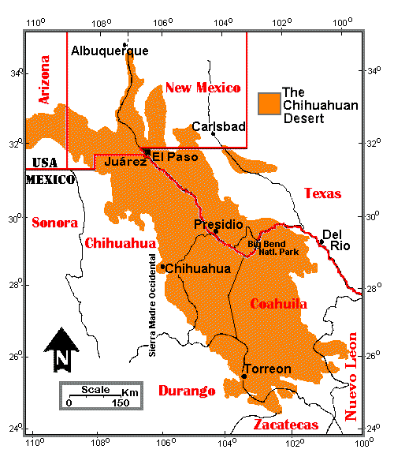
A Chihuahuan Desert Experiment Specification
Space and Time Constraints
Individual: <experiment-1.owl#region1>
Types:
elsewebdata:Region
Facts:
elsewebdata:hasUpperLatitude 35.0,
elsewebdata:hasRightLongitude -95.0,
elsewebdata:hasLowerLatitude 25.0,
elsewebdata:hasLeftLongitude -110.0
Individual: <experiment-1.owl#duration3>
Types:
elsewebdata:Duration
Facts:
elsewebdata:hasEndDate "0200-12-31T00:00:00-07:00"^^xsd:dateTime,
elsewebdata:hasStartDate "0201-02-28T00:00:00-07:00"^^xsd:dateTime

Slide 22
Ultimate ELSEWeb Goal
2
Denotes a duration of time encompassing a set of relevant environmental data
Data discovery, integration, transformation
1
These biomes are not defined solely by geographic coordinates; they are partially defined by its migrating flora (interpretation)
3
“I want to model the transition from grass lands to Chihuahuan desert (probably steppe), during historic periods of drought”
4
Drought denotes an event, that contextualizes a set of geospatial data within some space/time (interpretation)
ELSEWeb currently can support (1), but future work includes managing the complexities related to (2), (3), and (4)
Notes:
Identify the current and future work, perhaps by highlights. This is a work in progress, but we have some initial results for (1). This is achalleng that evolves but we are addressing the particular grant with was targeted with 1.

Slide 23
ELSEWeb and Prov-o
Each SADI service is configured to capture the input and output RDF as uniquely identified named graphs
<rdf:Description rdf:about=“namedGraph_1384383646553.rdf">
<j.3:wasGeneratedBy>
<j.4:prov-sadi.owlSadiService rdf:about="http://elseweb.cybershare.utep.edu/WCSCoverageRequirementsService">
<j.3:used>namedGraph_1384383646232.rdf</j.3:used>
</j.4:prov-sadi.owlSadiService>
</j.3:wasGeneratedBy>
</rdf:Description>
…
Satisfied
WCS Scenario
Requirements
WCS Scenario
Requirements
Tiff
Scenario
Tiff Extraction
Service
wasGeneratedBy
derivedFrom
wasGeneratedBy
used
used
derivedFrom
WCS
Requirements Service
WCS Scenario
Tiff Extracted WCS Scenario

Slide 24
Future Work – Tons of it!
Modeling:
connect to different models
work with different data providers
Provenance:
Aggregate SADI level provenance with lower level provenance from EDAC and Lifemapper
Reasoning work:
provide utility for users to identify events
associate changing regions with time

